Slide 1



[SUBSTITUTE APPROPRIATE LOGOS]
[TITLE]
EPCRA Tabletop Exercise
[COUNTY LOGO]
[FACILITY LOGO]
Presented by [FACILITATOR]
Sponsors and Participating Facility
Notes:
Project this slide during registration process

Slide 2
The materials for this exercise were developed in accordance with FEMA Homeland Security Exercise and Evaluation Program (HSEEP) guidelines in coordination with the U.S. Environmental Protection Agency (EPA) Region 2, New Jersey Office of Emergency Management (NJOEM), New Jersey Department of Protection (NJDEP), Burlington County OEM, Gloucester County OEM, and Middlesex County OEM.

Slide 3
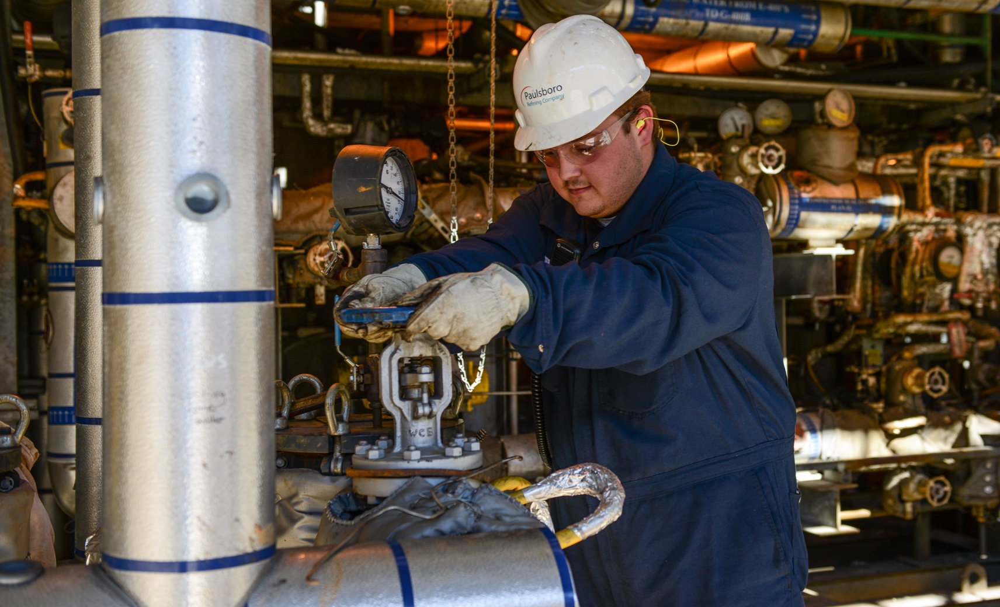
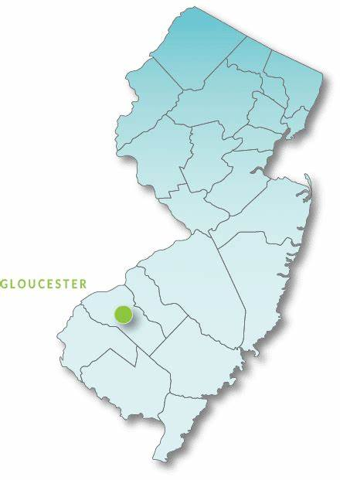
[EXERCISE TITLE]
Local Emergency Planning Committee Tabletop Exercise
[Insert facility picture and district map/pin]
[DATE]

Slide 4
Introductions
Index
Notes:
This is an index slide. DO NOT conduct introductions here, just tell ‘em what you’re going to tell ‘em. 15 minutes allotted for this entire section

Slide 5
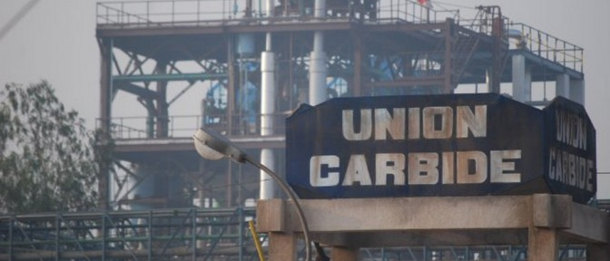
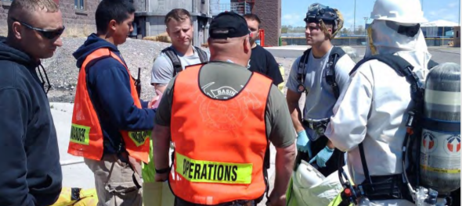
LEPC Introduction
Presenter: [NAME], [TITLE]
Bhopal, India, 1984
What is a Local Emergency Planning Committee (LEPC)?
What is the Emergency Planning and Community Right-to-Know Act?
Notes:
Time goal – 2 minutes
In early December 1984, methyl isocyanate, an extremely toxic chemical, escaped from a Union Carbide chemical plant in Bhopal, India. Thousands died and many more were injured. Some suffered permanent disabilities. Approximately six months later, a similar incident occurred in West Virginia.
Less than a year after the Bhopal tragedy, a small cloud of a toxic chemical leaked from another Union Carbide plant in West Virginia. Though there were no fatalities, this incident sent 134 individuals to the hospital. In the wake of these two accidents, there were demands for increased coordination and communication between the chemical industry and state, tribal, local, and federal partners.
In response to these concerns, Congress passed the Emergency Planning and Community Right-to-Know Act in 1986. EPCRA establishes requirements for federal, state and local governments, Indian tribes, and industry regarding emergency planning and “Community Right-to-Know” reporting on hazardous and toxic chemicals. The Community Right-to-Know provisions help increase public’s knowledge and access to information on chemicals at individual facilities, their uses, and releases into the environment. States and communities, working with facilities, can use the information to improve chemical safety and protect public health and the environment.

Slide 6
Facility Overview
Presenter: [NAME], [FACILITY]
Notes:
Introduce [facility] representative, __________
Representative provided slides 7 & 8
Time goal for all slides – 2 minutes

Slide 7
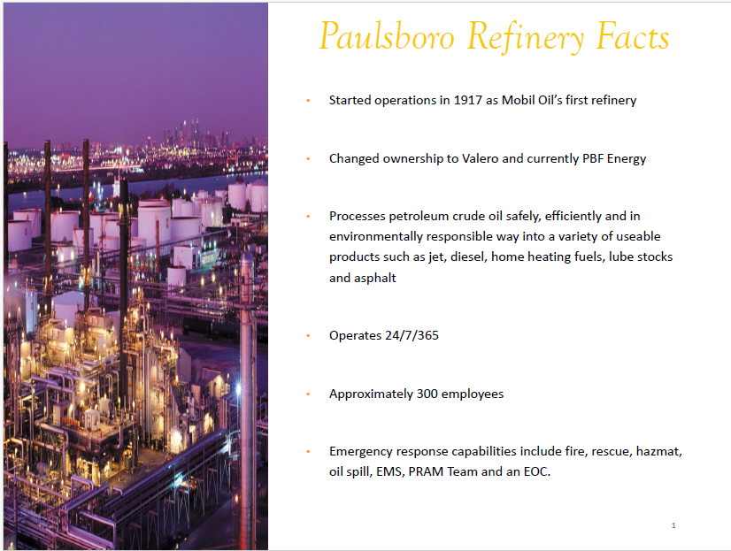
[SUBSTITUTE RELEVANT FACILITY FACTS]

Slide 8
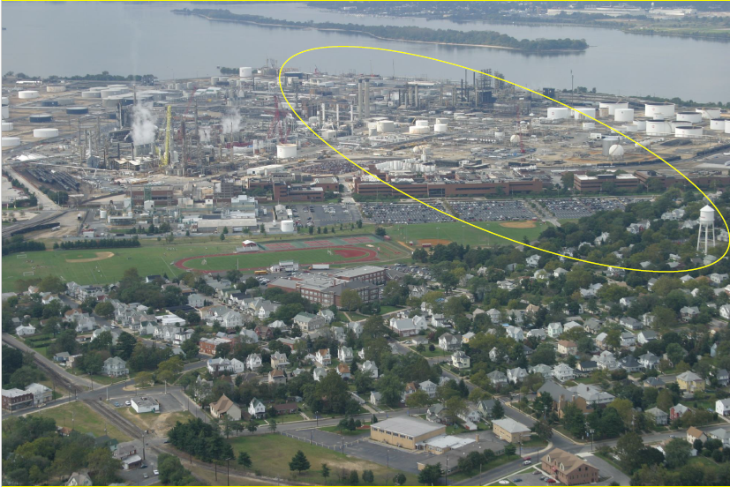
[SUBSTITUTE RELEVANT FACILITY PHOTO]

Slide 9
Facilitators
[FACILITATOR LOGO]
[NAME], [AFFILIATION]
[NAME], [AFFILIATION]
[ROLES]
Notes:
Facilitator introductions – <1 minute

Slide 10
Participants
                Name?
                Organization?
                Tell us something about you that nobody else in the room knows)
Notes:
Placeholder for participant introductions
Icebreaker question? – Tell us something about you that nobody else in the room knows (PG rated)
Time goal 5 minutes

Slide 11
Exercise Schedule
[ADJUST TIMES AS NEEDED]
Time | Activity
8:00 a.m. – 8:45 a.m. | Registration
8:45 a.m. – 9:00 a.m. | Welcome and Introductions
9:00 a.m. – 9:15 a.m. | Module 1: Facility Notifications
9:15 a.m. – 9:45 a.m. | Module 2: Local Agency Notifications
9:45 a.m. - 10:00 a.m. | Break
10:00 a.m. – 10:30 a.m. | Module 3: Risk Assessment
10:30 a.m. – 11:00 a.m. | Module 4: Public Notification
11:00 a.m. – 11:15 a.m. | Module 5: Documentation and Investigation
11:15 a.m. – 11:30 a.m. | Hotwash and Closing Comments
Notes:
Exercise schedule
Time goal <1 minute

Slide 12
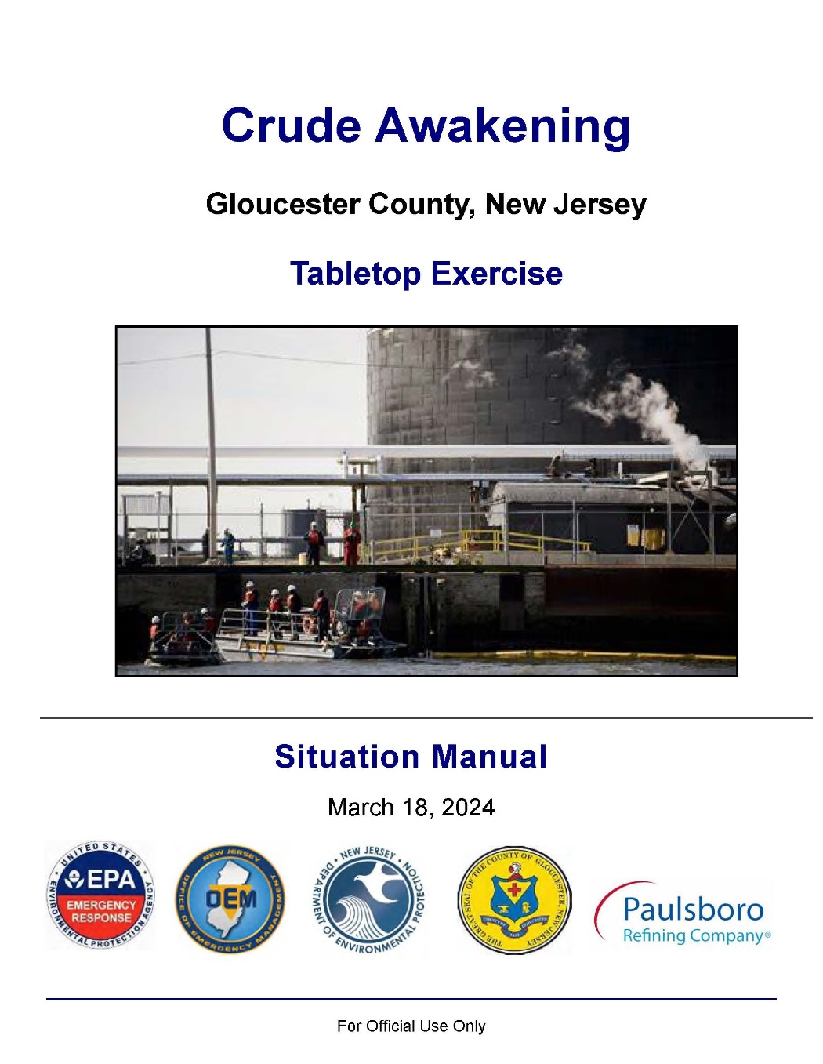
Administrative Remarks
[SUBSTITUTE YOUR SITUATION MANUAL TITLE PAGE]
Phones and radios on silent
Emergency procedures
Situation Manual
Participant Feedback Form
Notes:
Admin Remarks
Time goal – 1 minute

Slide 13
Purpose
Evaluate player actions against [County] Emergency Planning District’s Offsite Emergency Response Plan for a release of a hazardous material.
Notes:
Purpose
Time goal – 30 seconds

Slide 14

Why Do We Exercise?
Recognize roles and responsibilities.
Identify gaps.
Identify future needs.
Promote collaboration.
Meet regulatory and industry standards.
Notes:
Why Do We Exercise?
Time goal 30 seconds
Recognize roles and responsibilities.
Identify gaps in planning and preparedness.
Identify future training needs.
Promote inter-agency collaboration.
To meet regulatory and industry standards.

Slide 15
What is a Tabletop Exercise (TTX)?
Informal discussion stimulated by a scripted scenario.
No time pressures; low stress; promotes the free and open exchange of ideas.
Familiarizes players with roles, functions, plans, and procedures.
Goal is constructive discussion from all participants seeking opportunity to improve policy, procedures, and plans.
Notes:
What is a TTX?
Time goal 30 seconds

Slide 16
Exercise Ground Rules
Open, low-stress, no-fault environment with varying viewpoints.
Responses are based on the current plans and capabilities.
Decisions are not precedent setting.
Players are encouraged to discuss issues in depth.
Notes:
This is an open, low-stress, no-fault environment; varying viewpoints, and even disagreements, are expected.
Responses are based on the current plans and capabilities of each agency or organization.
Decisions are not precedent setting; consider different approaches and suggest improvements.
Players are encouraged to discuss issues in depth.

Slide 17
Assumptions & Artificialities
  The scenario is plausible, and events occur as presented.
  Minor details do not matter.
  There are no “hidden agendas” or “trick” questions.
  Assume cooperation and support from non-participating departments.
Notes:
In any exercise, a number of assumptions and artificialities may be necessary to complete play in the time allotted. During the exercise, the following apply:
Time goal 30 seconds

Slide 18
Scope
[ADJUST TIMES/ACTIVITIES AS NEEDED]
2.5-Hour Facilitated Tabletop Exercise (TTX):
Module 1: Facility Notifications
Module 2: Local Agency Notifications
Module 3: Risk Assessment
Module 4: Public Notification
Each module is comprised of:
Open and active facilitated discussion
Scenario update
Discussion of various issues
Module 5: Documentation and Investigation
Notes:
Time goal 30 seconds

Slide 19
Capabilities to be Evaluated
Public Information and Warning
Environmental Response/ Health and Safety
Situational Assessment
Notes:
Time goal 30 seconds

Slide 20
Start of Exercise (STARTEX)
Module 1: Facility Notifications
Index
Notes:
Module 1 – Facility Notifications
This is an index slide
Time goal for this Module is 15 minutes

Slide 21

Scenario
Typical early [season] [morning/night] in [COUNTY].
Employees at the [MUNCIPALITY] [FACILITY] are about to change shifts.
Approximately [388] employees at the site.
[DATE]
[TIME]

Slide 22
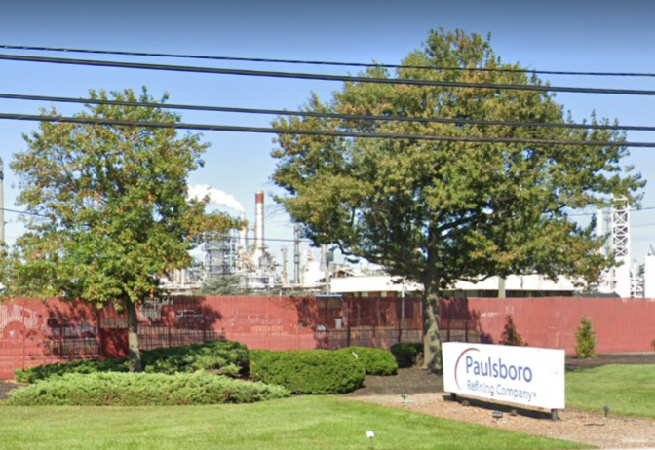
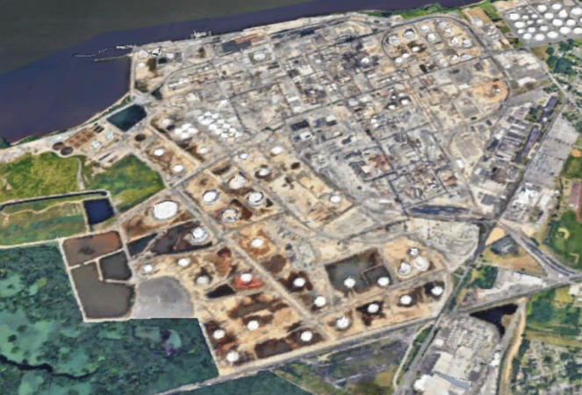
[SUBSTITUTE FACILITY PICTURE/MAP]
[FACILITY NAME]

Slide 23
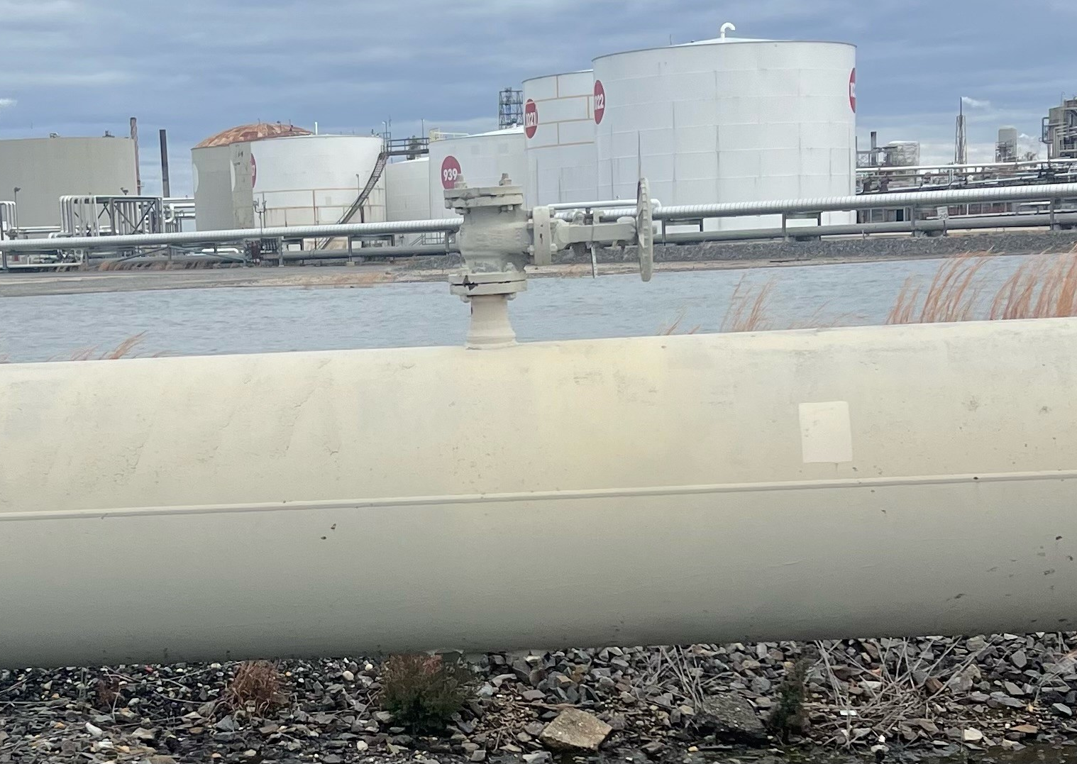
Scenario (cont.)
[SUBSTITUTE FACILITY SCENARIO]
Sour crude oil, containing hydrogen sulfide (H2S), begins to leak from a flange of the 30-inch ship-to-shore transfer line.
Operator notices the leak.
Operator determines the leak cannot be controlled manually and unsafe for internal HAZMAT Team response.

Slide 24

Discussion Questions
    1. What notifications will be made by the plant, and who will make these notifications?

Slide 25
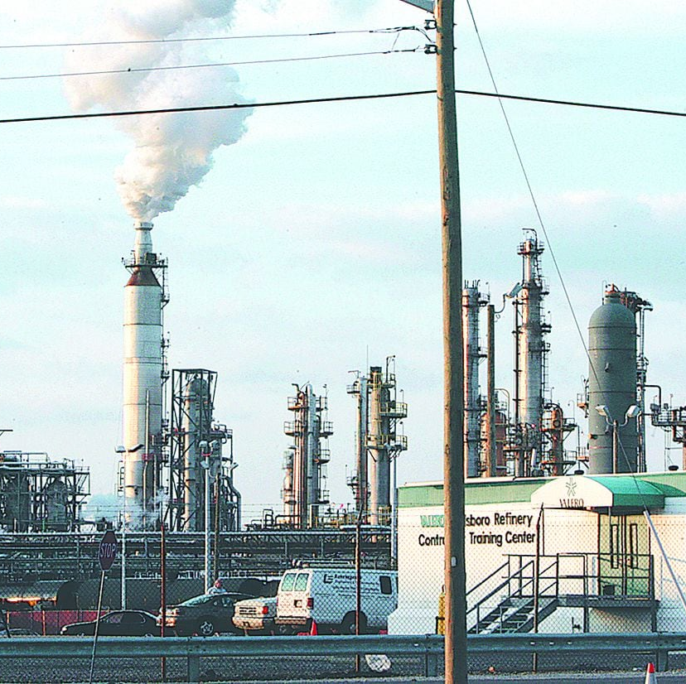
Discussion Questions (cont.)
[SUBSTITUTE FACILITY PHOTO]
Will employees be instructed to evacuate or shelter-in-place (SIP)? Who makes this determination and how?
How will employees be notified whether to evacuate or SIP?

Slide 26
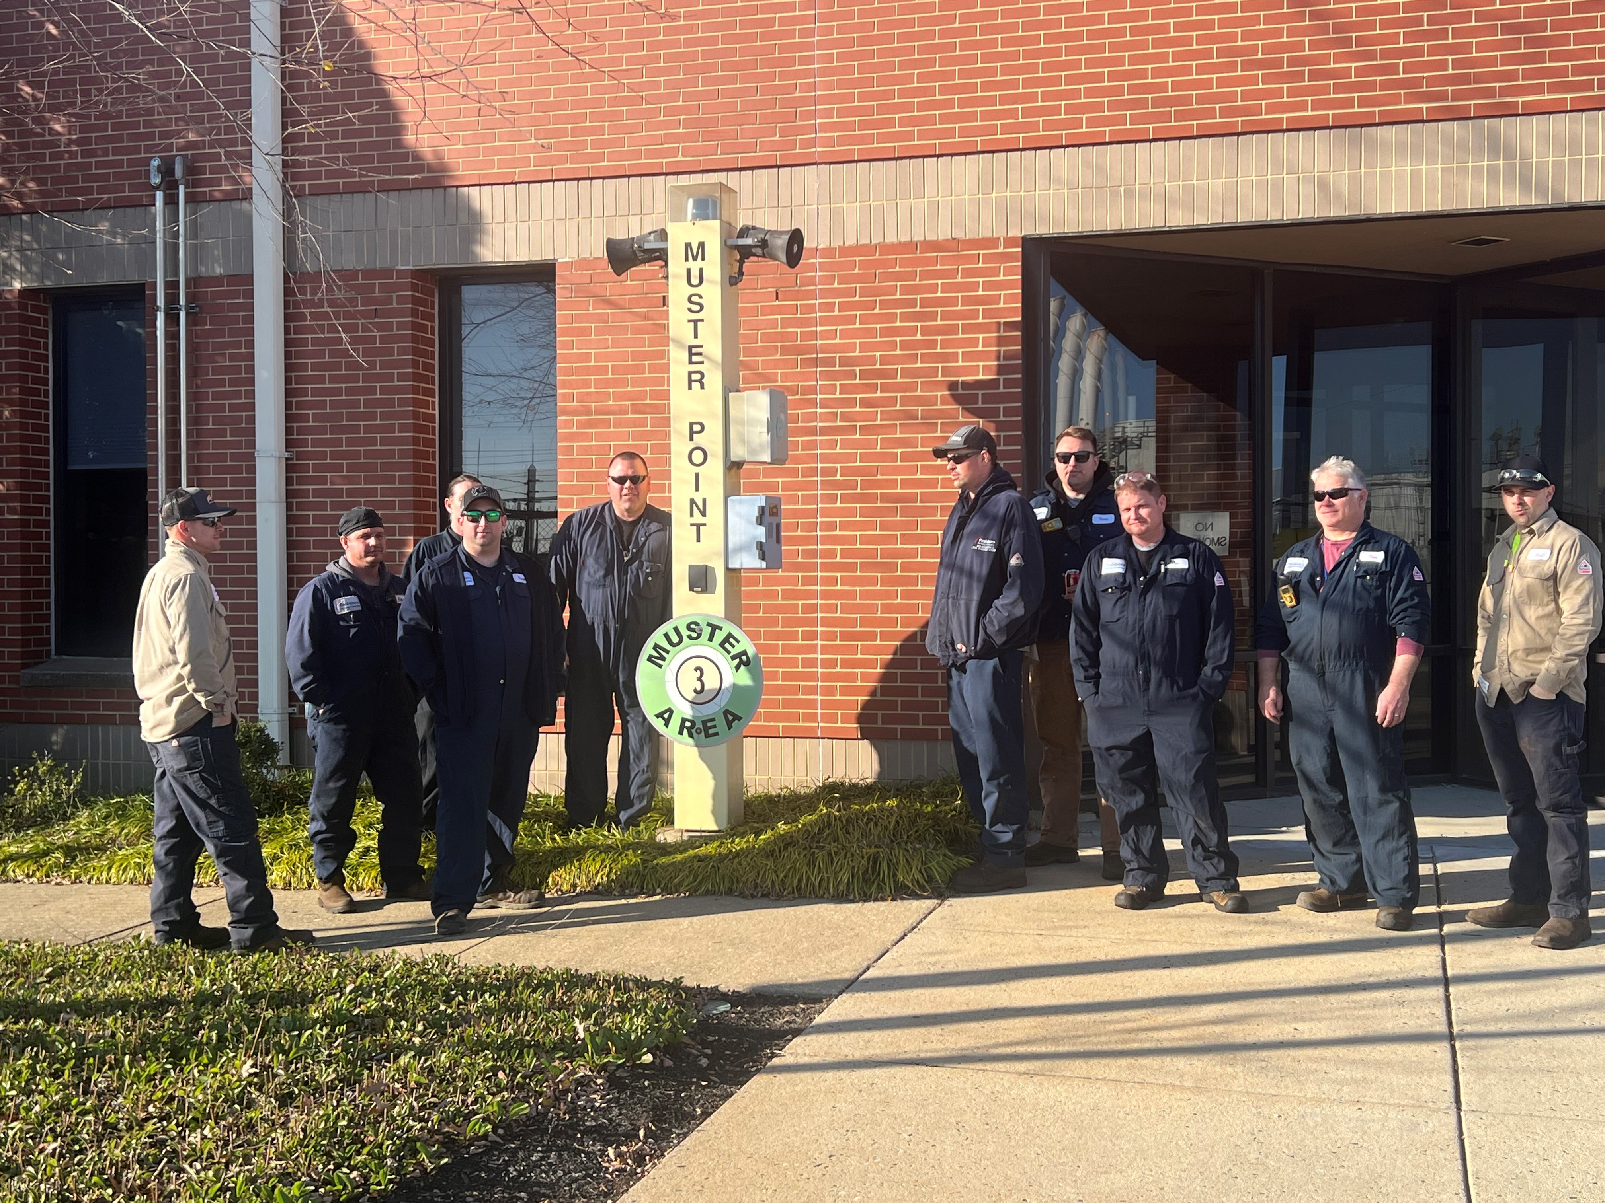
Discussion Questions (cont.)
[SUBSTITUTE FACILITY PHOTO]
If it is determined that evacuation is necessary, what instructions will be provided to employees? If the decision is made to SIP, what instructions will be provided?
How will employees, contractors, and visitors be accounted for?
Who will assume the role of [MUNICIPALITY FACILITY] Incident Commander (IC)?

Slide 27
Module 2: Local Agency Notifications
Index
Notes:
Module 2 – Local Agency Notifications
This is an index slide
Time goal for this Module is 30 minutes
(Start 9:15 a.m. – end 9:45 a.m.)

Slide 28

Scenario
9:15 a.m.
A representative from the [FACILITY] calls 9-1-1 to report the [CHEMICAL NAME] release.

Slide 29
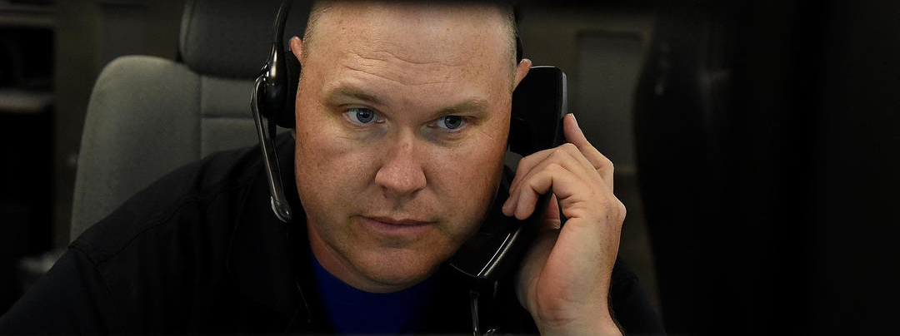
Discussion Questions
What information should the 9-1-1 Dispatcher obtain from the caller?

Slide 30
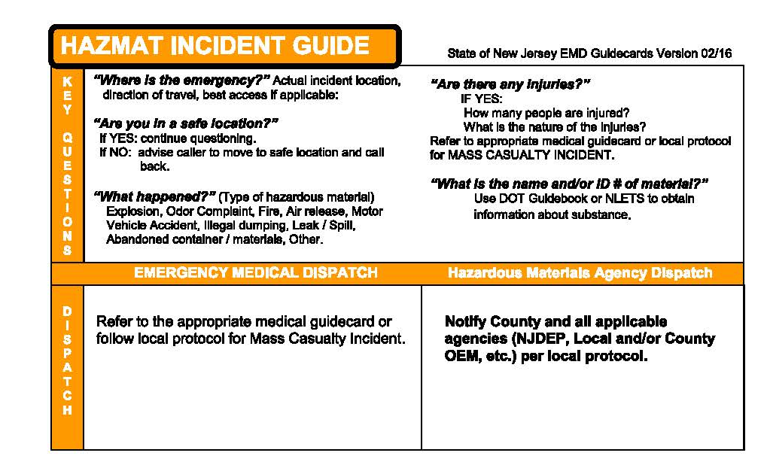
NJ EMD Guide (1 of 2)
Source: State of New Jersey Emergency Medical Dispatch Guidecards – 2/11/2020
Notes:
HazMat Incident Guide (1 of 2)
The hazmat incident guide is a card or programmed screen that is a national standard for dispatchers.
After discussion. facilitator asks the players: “How does this card compare with the Off-site ERP? (pp9 & 10 D.4.a through h)”

Slide 31
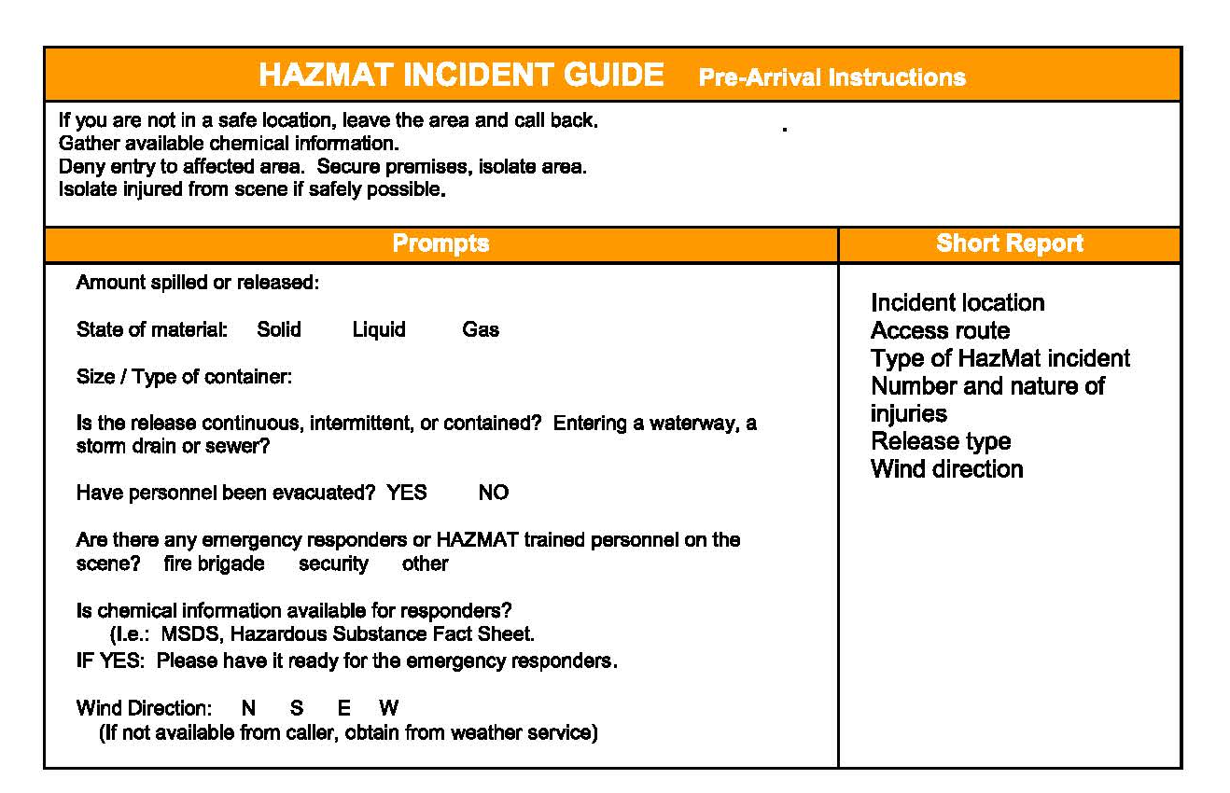
NJ EMD Guide (2 of 2)
Source: State of New Jersey Emergency Medical Dispatch Guidecards – 2/11/2020
Notes:
HazMat Incident Guide (2 of 2)
The hazmat incident guide is a card or programmed screen that is a national standard for dispatchers.
After discussion facilitator asks the players: “How does this card compare with the Off-site ERP? (pp__ & __ D.4. A through H)”

Slide 32
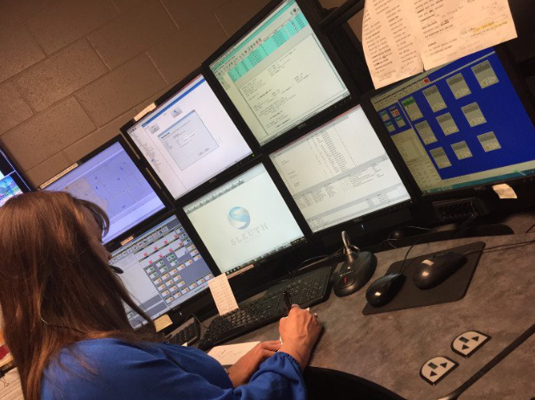
Discussion Questions (cont.)
What notifications will the 9-1-1 comms center make?
If the [CHEMICAL NAME] release was reported to the 9-1-1 comms center by someone other than a [MUNICIPALITY] representative, what notifications would the 9-1-1 comms center make?

Slide 33

Discussion Questions (cont.)
How will the LEPC Community Emergency Coordinator be notified?
What notifications will the LEPC Emergency Coordinator make?

Slide 34
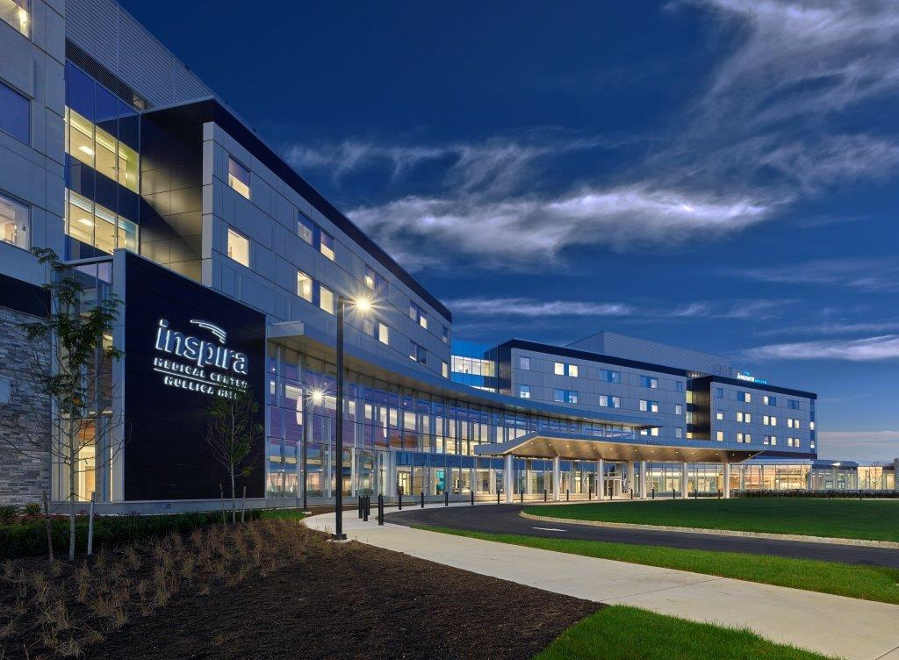
[SUBSTITUTE HOSPITAL PICTURE]
Discussion Questions (cont.)
Once notified, who will the [COUNTY] OEM notify?
What agency is responsible for notifying adjoining jurisdictions, counties, or states of the release?
Who will contact local hospitals to advise them to prepare to receive potentially contaminated victims?
What are their capabilities?
Notes:
For #7, add “or State”, if applicable
At the end of Module 2 (if time permits), call for a 15 minute break.
Scheduled break time is 9:45 a.m. till 10:00 a.m.

Slide 35

Module 3: Risk Assessment
Notes:
Module 3 Risk Assessment
This is an index slide
After returning from break, begin Module 3.
(Module is scheduled for 30 minutes, 10:00 a.m. till 10:30 a.m.)

Slide 36

Scenario
[SUBSTITUTE AGENCY LOGO]
10:00 a.m.
9-1-1 comms center has completed all necessary notifications and has dispatched the [MUNICIPALITY] Fire Company and [COUNTY] HAZMAT Team to the [FACILITY].

Slide 37
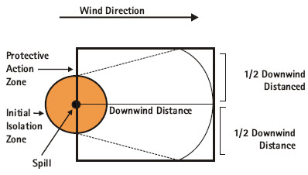
Discussion Questions
What entity will lead the response?
What initial isolation distance will be established? Who will make this determination and what resource(s) would be used to make this determination?
Who will conduct plume modeling and what resource(s) will be used?
Notes:
CERES (new) – includes option to upload Tier2 information
Cameo (well known modeling program)
RMPComp (less well known; available via internet) RMP = Risk Management Program (EPA regulation 40 CFR 112R)
Reg requires facility to run “Worst case scenario” and “Alternate Scenario”.

Slide 38

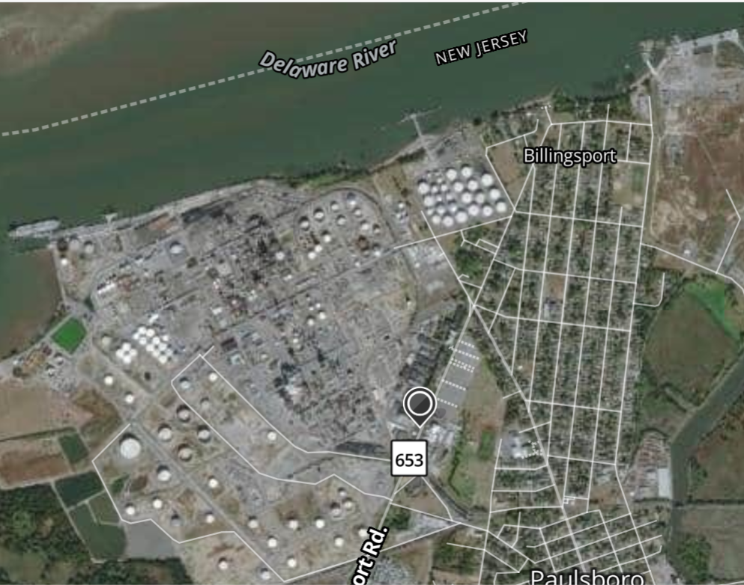
[SUBSTITUTE APPROPRIATE PLUME MODELING]
According to the plume model, the plume is heading in a southeast direction toward a residential area.

Slide 39
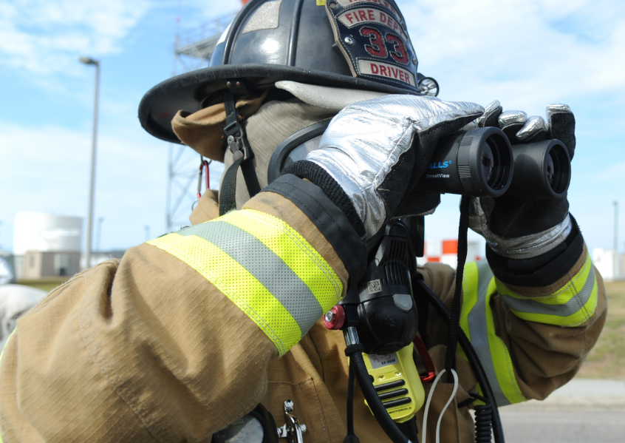
Discussion Questions (cont.)
Who will decide whether members of the impacted community should evacuate or SIP? How is this decision made?
What role does the LEPC have in determining or supporting whether residents evacuate or SIP?

Slide 40
Module 4: Public Notification
Notes:
Module 4 Public Notifications
This is an index slide
(Module is scheduled for 30 minutes, 10:30 a.m. till 11:00 a.m.)

Slide 41
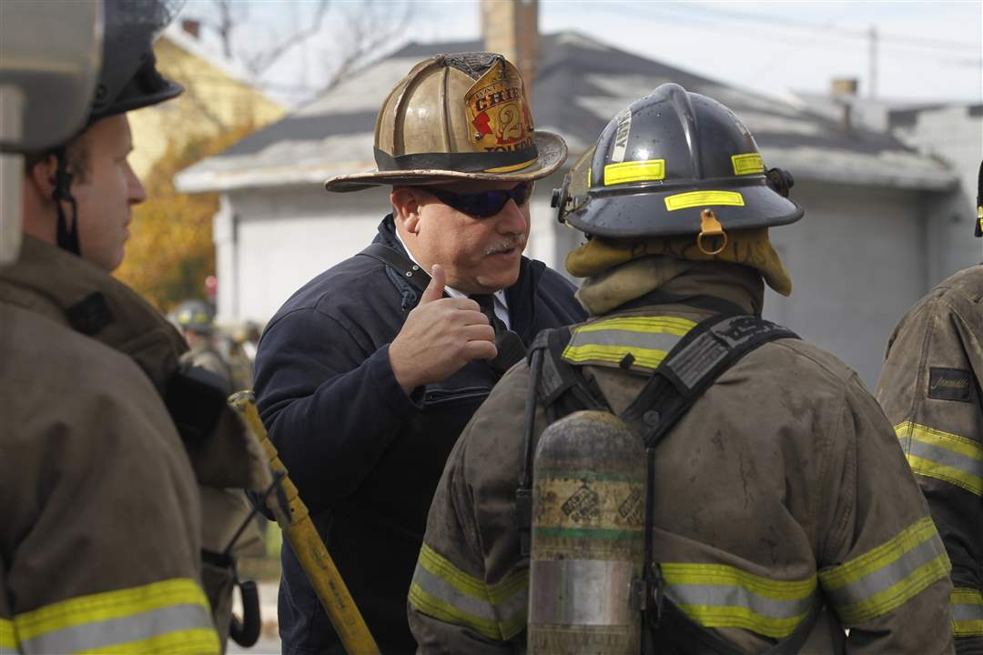
Scenario
10:30 a.m.
The decision has been made to have residents shelter-in-place in the impacted area.

Slide 42
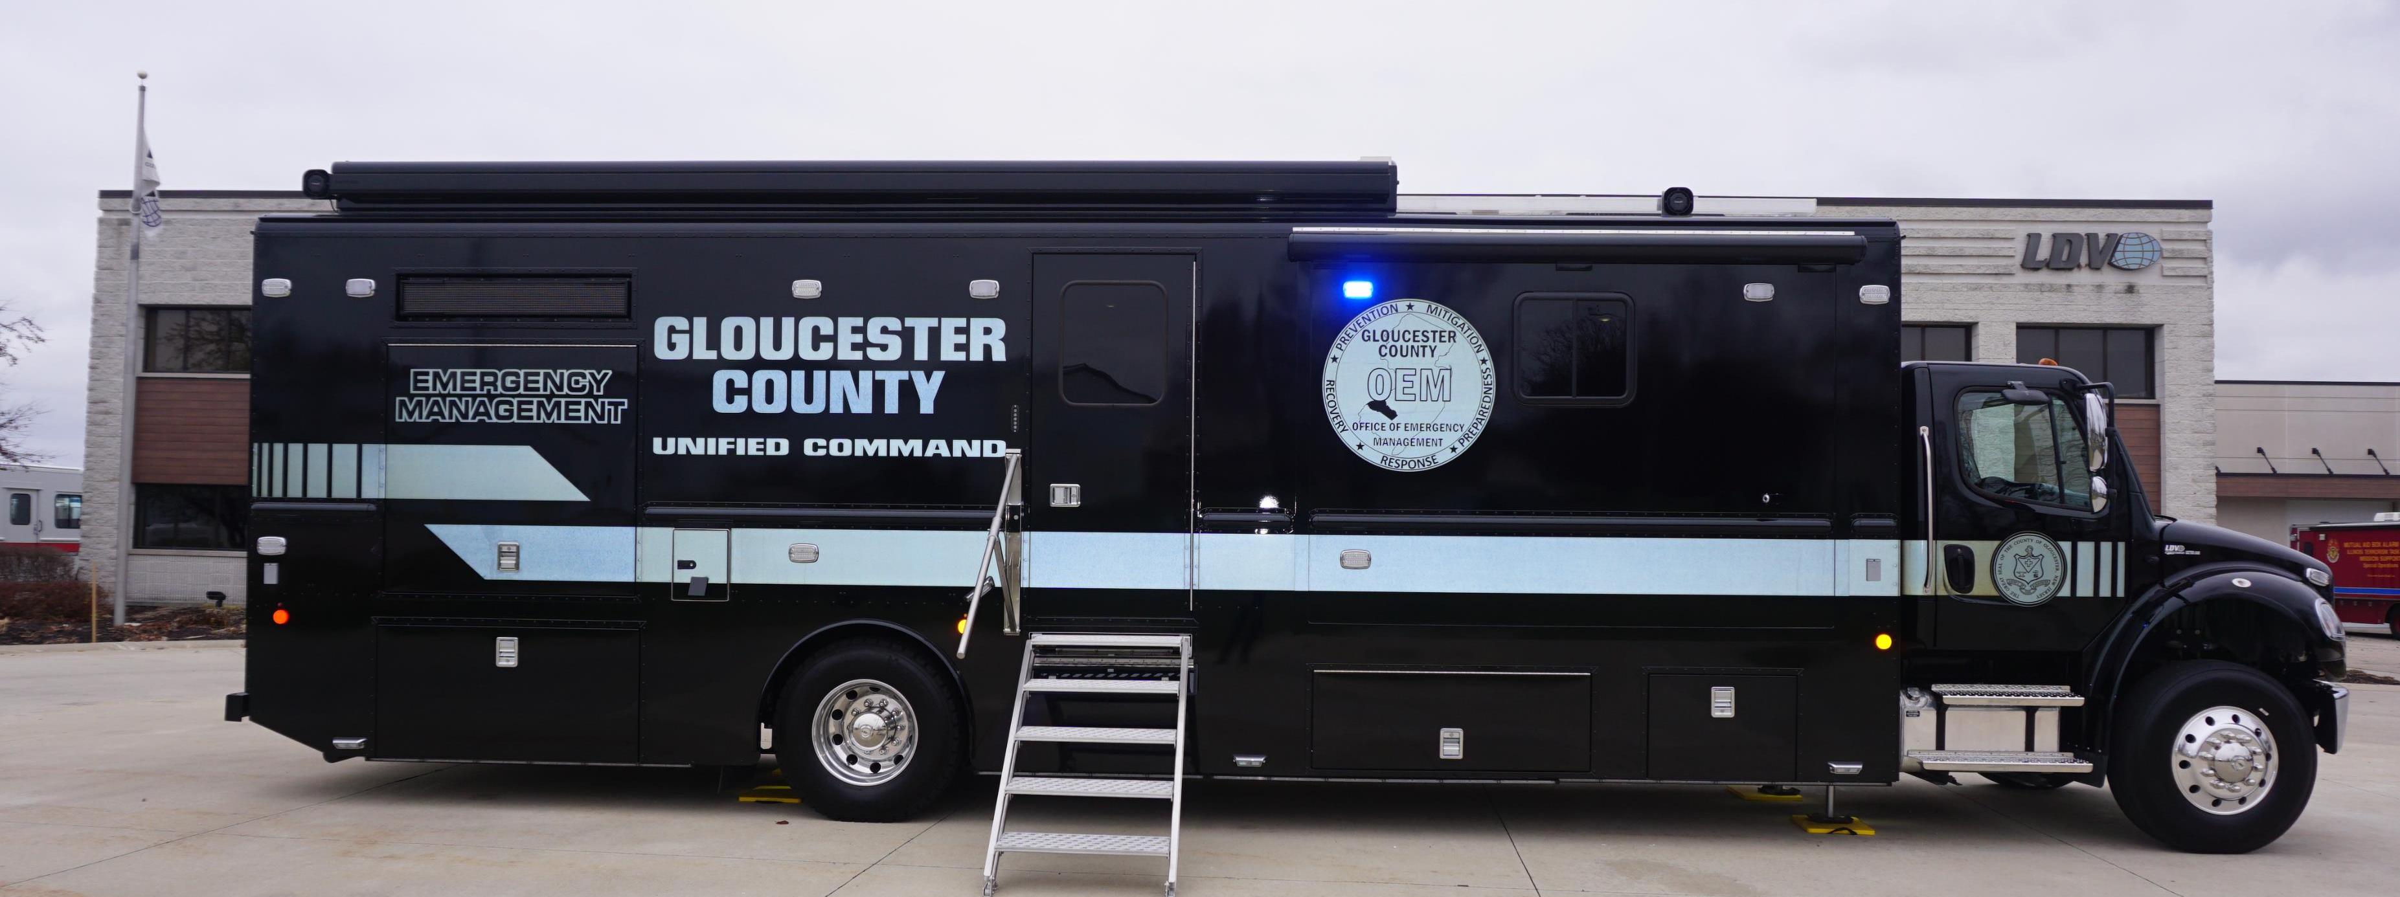
Discussion Questions
[SUBSTITUTE RELEVANT PHOTO]
Who is responsible for notifying affected residents they should SIP?
What method(s) will be used to provide the public with SIP instructions? What specific instructions will be provided?

Slide 43
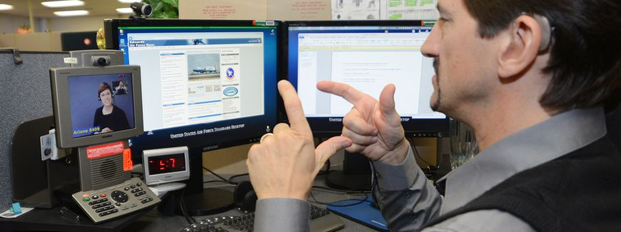
Discussion Questions (cont.)
How will individuals with disabilities, access and/or functional needs, language restrictions, and other vulnerabilities receive shelter-in-place instructions?
Besides the public, what additional stakeholders need to be notified and who will notify them?

Slide 44

Scenario
10:45 a.m.
A rumor is started on social media that [__ people are deceased and _____ sickened by the air release].
9-1-1 staff are overwhelmed with requests for emerge­ncy services.

Slide 45
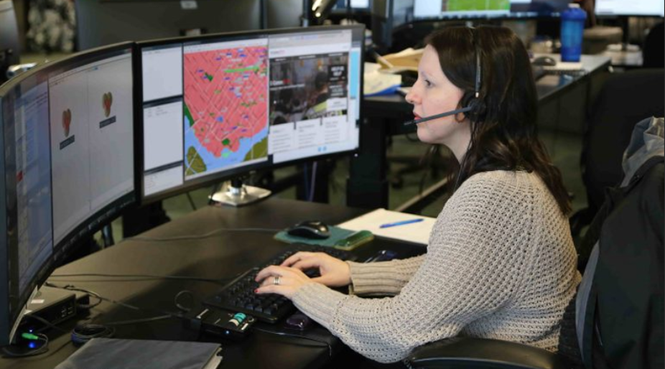

Discussion Questions (cont.)
How will social media be monitored to address rumors and false/inaccurate information?
How would 9-1-1 deal with the surge of calls coming in?

Slide 46
Module 5: Documentation and Investigation
Notes:
Module 5 – Documentation and Investigation
This is an index slide
(Module is scheduled for 15 minutes, 11:00 a.m. till 11:15 a.m.)

Slide 47

Scenario
It has now been 30 days since [MUNCIPALITY FACILITY] first reported the [CHEMICAL NAME] release from their facility.

Slide 48

Discussion
Questions
What follow-up reporting is the [FACILITY] required to make and to what agency(ies)?
How will the [COUNTY] LEPC document and evaluate the [CHEMICAL] release incident?
Who will be responsible for sharing information about the incident to the public and other stakeholders?

Slide 49
ENDEX
Hotwash

Slide 50

Exercise Hotwash
Identify strengths to be maintained and/or enhanced

Slide 51

Exercise Hotwash
Identify opportunities to strengthen preparedness, response, and/or recovery capabilities

Slide 52

Participant Feedback
Closing Remarks
[INSERT SURVEY COLLECTION METHOD PICTURE/LOGO]

Slide 53
Thank you for participating!
[COUNTY] TTX Participant Feedback Survey
Participant Feedback
Closing Remarks
[INSERT QR CODE TO SURVEY COLLECTION METHOD]
Notes:
Call on facility host (_____________) and other principals? For closing remarks while people (hopefully) fill out the survey.
Dismiss audience
Ask evaluators to remain for evaluator Hot Wash?

